Slide 1
Zendesk Guide for Partners

Slide 2
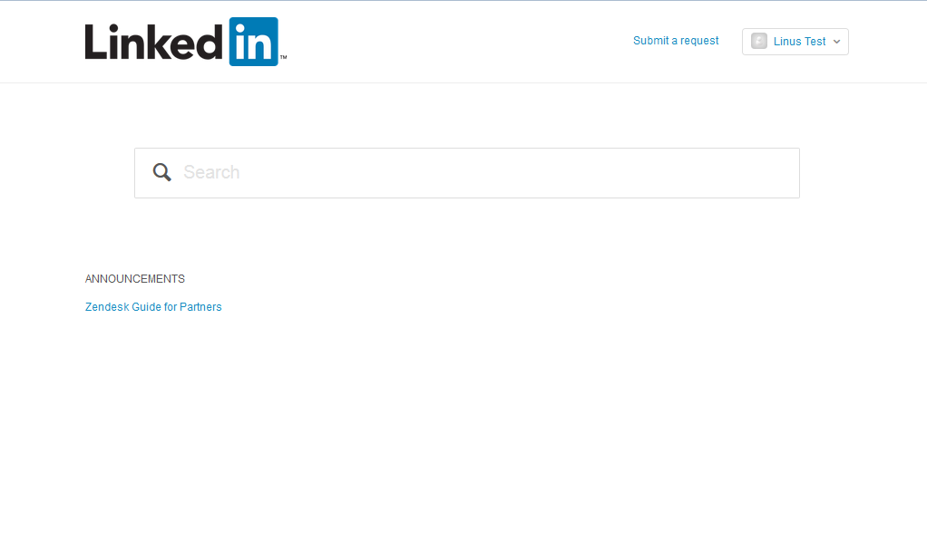
Step 1: Go to: https://linkedinpartners.zendesk.com
Step 2: Make sure you are logged in
Step 3: Click on “Submit a request”

Slide 3
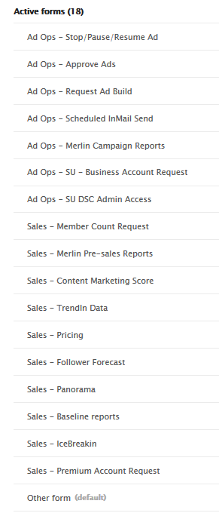
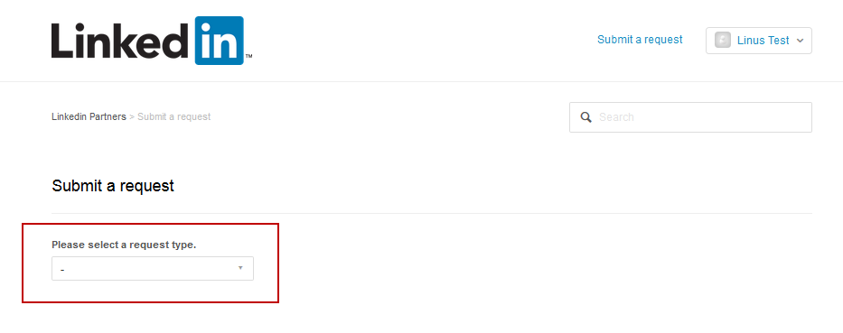
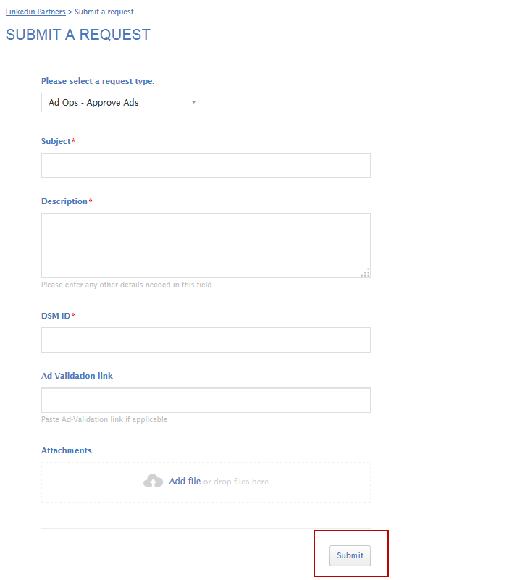
Step 4) Choose the correct request type
Here is a list of request types:
Step 5) Fill in the request and submit!
Step 6) Done!!!

Slide 4
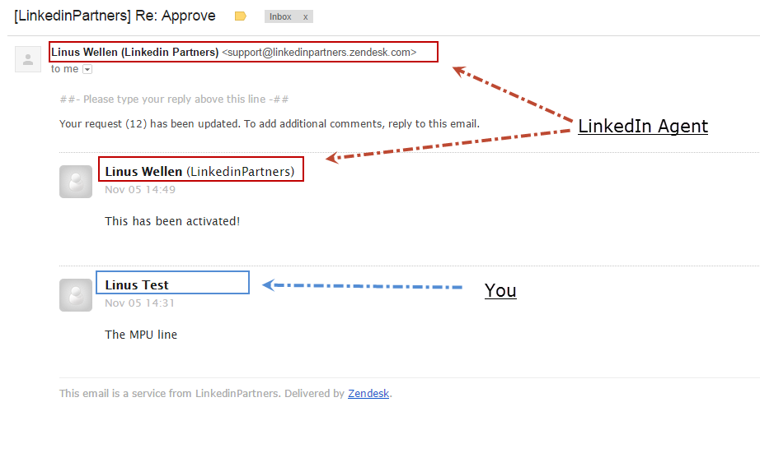
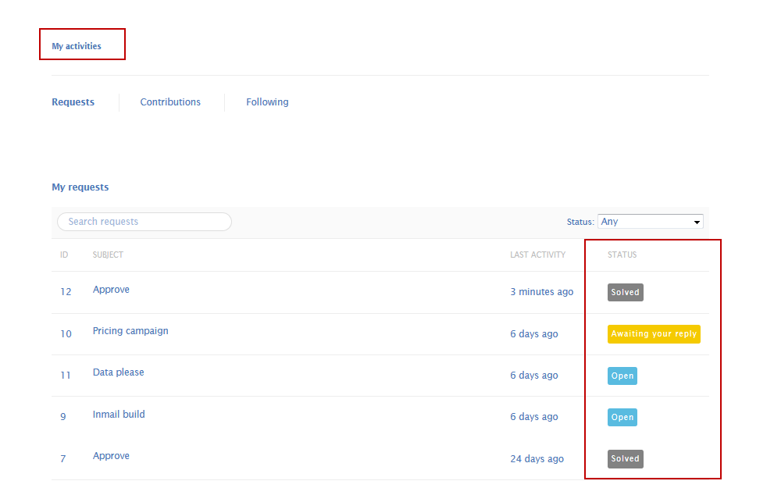
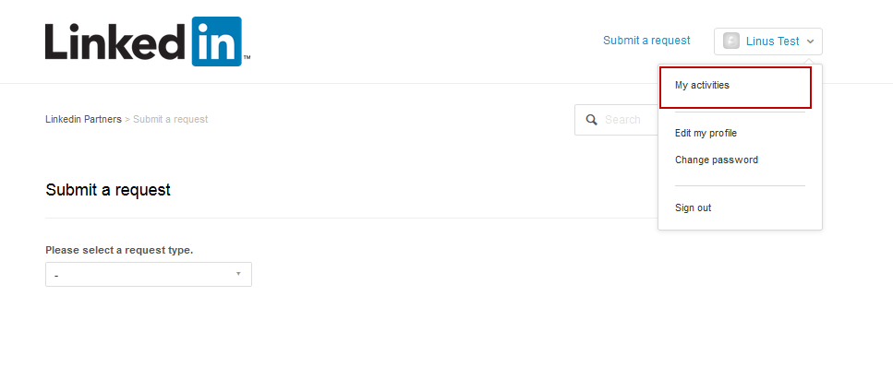
When your LinkedIn agent has replied to your request you get an email notification:
You can check the status of your organisation’s requests in “My activities”

